Slide 1
Fourier Transform

Slide 2
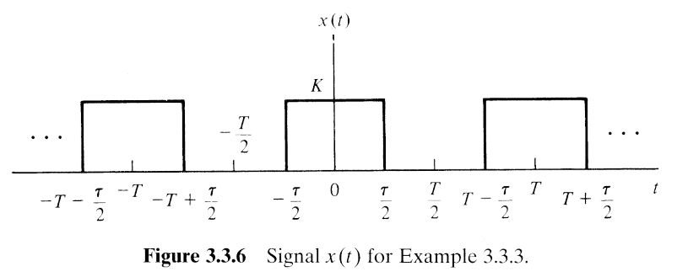
The continuous-time Fourier transform
T 증가
→ amplitude & line spacing 감소
If T → ∞ ?

Slide 3
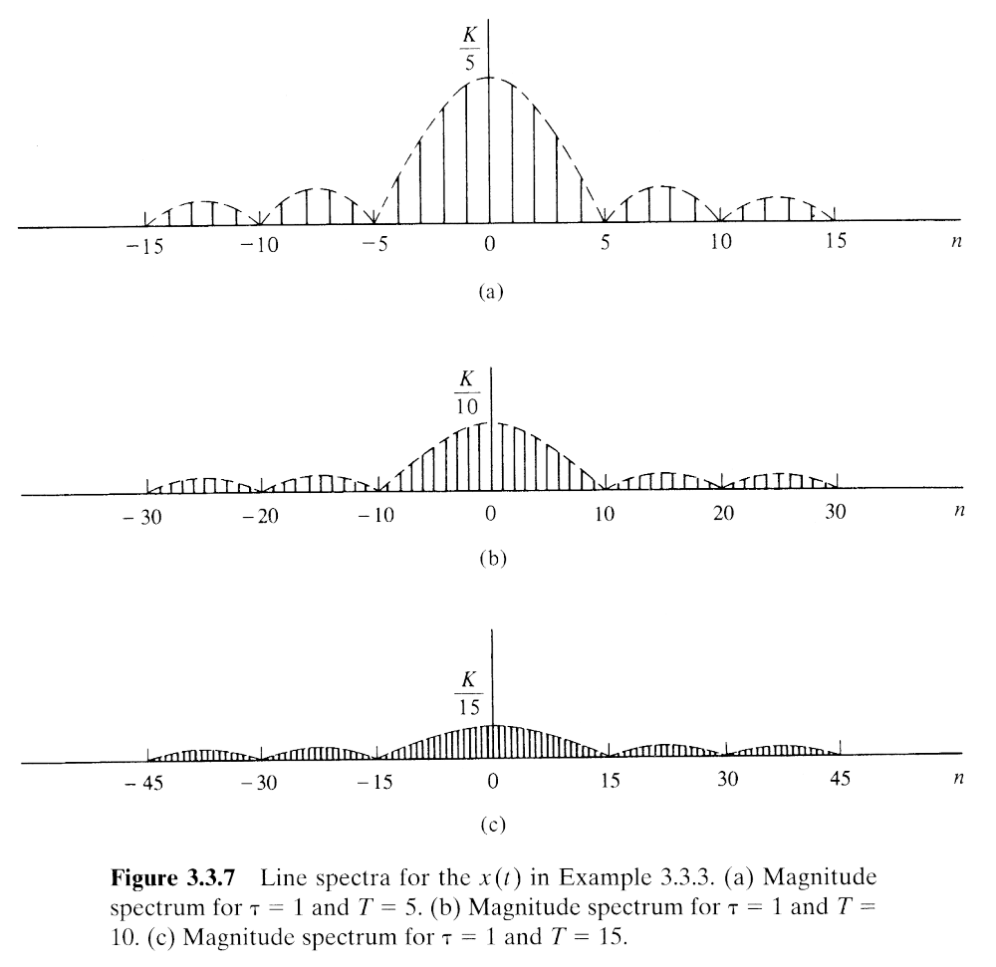







The Exponential Fourier Series
if) K = 1, τ = 1
T 를 증가시킨다면?
T=5, f=1/5
0
f(Hz)
T=10, f=1/10
0
f(Hz)
T=15, f=1/15
0
f(Hz)

Slide 4
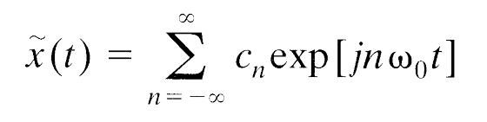
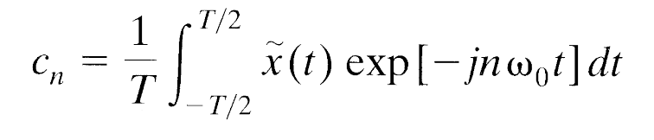

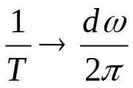
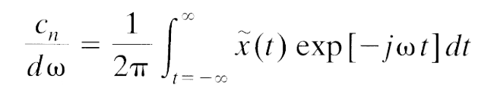
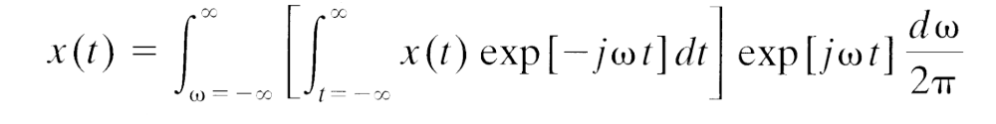
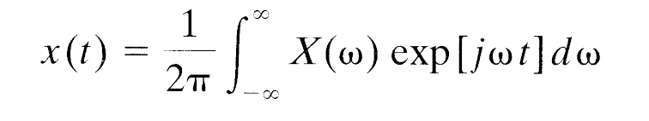
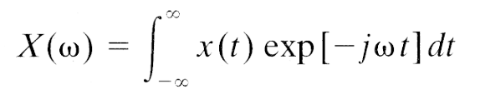
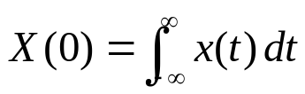
Development of the Fourier Transform
Fourier series
T → ∞,
→ 0 or d ,

Slide 5


Existence of the Fourier Transform
exists
  is absolutely integrable
  is “well behaved.” – can be represented by a curve of finite length in any finite interval of time, that the signal has a finite number of discontinuities, minima, nad maxima within any finite interval of time.

Slide 6
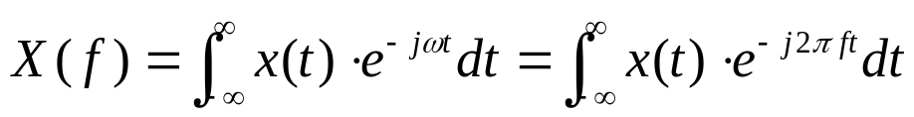

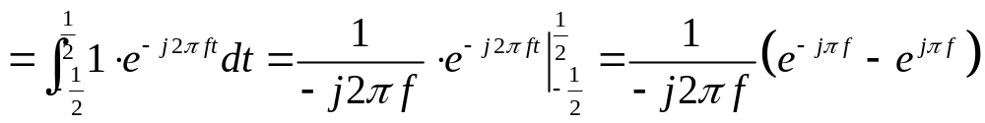
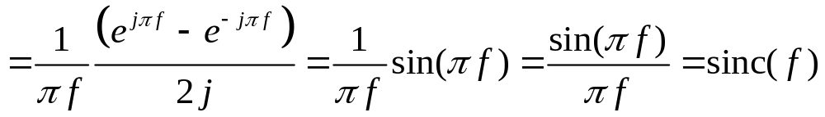



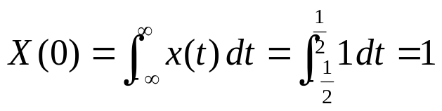
Examples of the Continuous-Time Fourier Transform

Slide 7
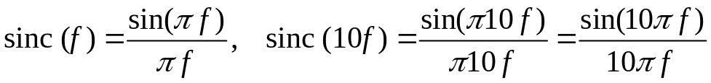
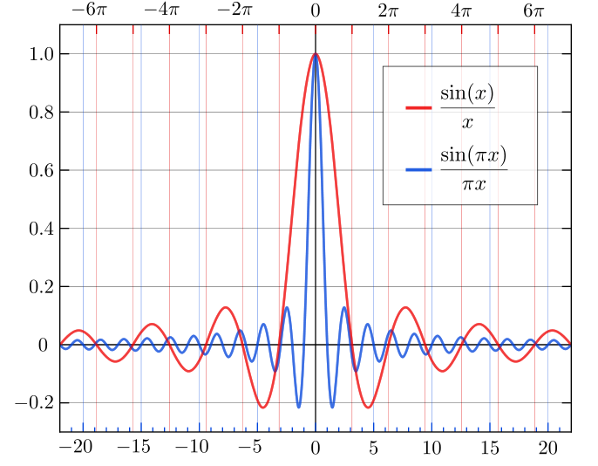
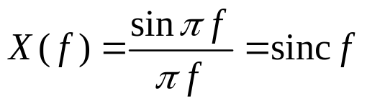
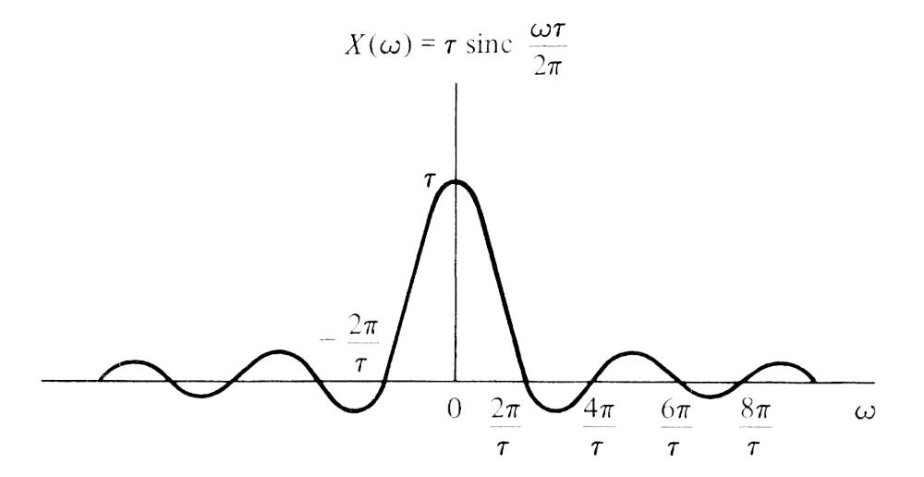
Examples of the Continuous-Time Fourier Transform
1
-5
-4
-3
-2
-1
0
1
2
3
4
5
f (Hz)

Slide 8
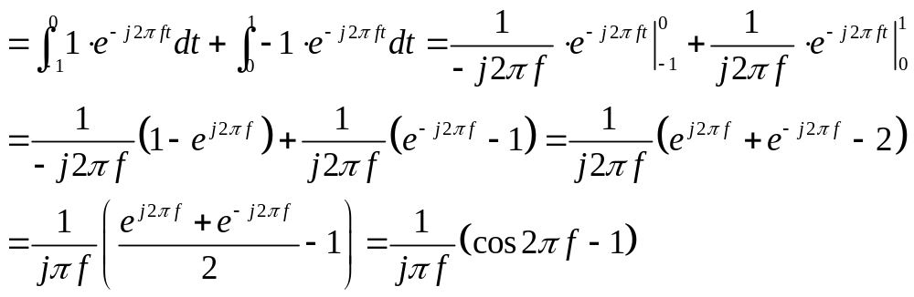

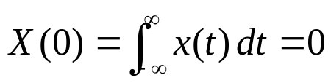
Examples of the Continuous-Time Fourier Transform

Slide 9


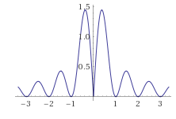









Examples of the Continuous-Time Fourier Transform

